Slide 1

SQL Queries

Slide 2

AGENDA
01
02
03
Managing db vs Querying
Common Sql Terminology
Database Normalization
04
05
Sql Dialects
Connecting to DB

Slide 3
Managing vs Querying
Creating, deleting, altering tables in database
Deciding who accesses which tables in which database
Creating reports and generating insights
Pulling data to do ML

Slide 4
Managing vs Querying
Creating, deleting, altering tables in database
Deciding who accesses which tables in which database
Creating reports and generating insights
Pulling data to do ML
DDL, DCL
DML

Slide 5
Managing vs Querying
Creating, deleting, altering tables in database
Deciding who accesses which tables in which database
Creating reports and generating insights
Pulling data to do ML
DDL, DCL
DML
As a data scientist, you will end up doing this most of the times

Slide 6
Managing vs Querying
Creating, deleting, altering tables in database
Deciding who accesses which tables in which database
Creating reports and generating insights
Pulling data to do ML
You may have to do some data engineering work and knowing this will help
DDL, DCL
DML

Slide 7
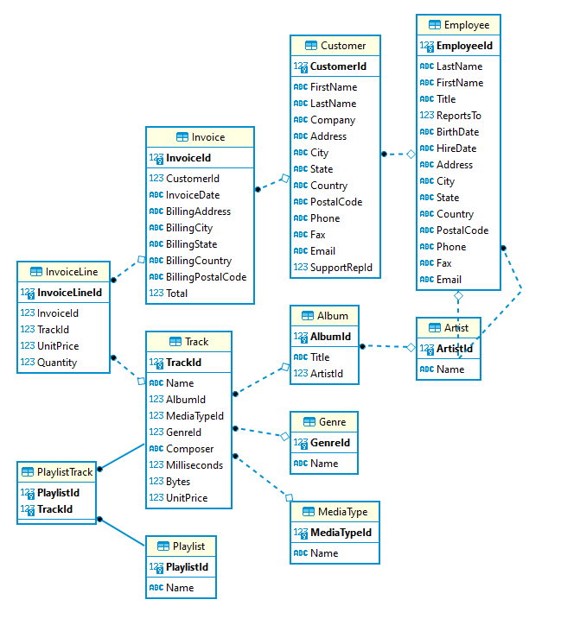
DML: Manipulating tables in a DB

Slide 8
DML: Manipulating tables in a DB

Slide 9
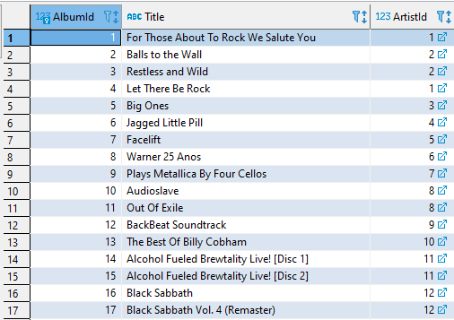
DML: Manipulating tables in a DB
Data Types

Slide 10
DML: Manipulating tables in a DB
INTEGER
VARCHAR
INTEGER

Slide 11
DML: Manipulating tables in a DB
INTEGER
VARCHAR
INTEGER

Slide 12
DML: Manipulating tables in a DB
SELECT statement
SELECT statement + expressions
SELECT + WHERE
SETS
JOINS
UNION
SUBQUERIES

Slide 13
SELECT Statement
SELECT cols from table;\
Show all Album Titles:
SELECT Title from Album;
SELECT Title from Album limit 5;
Show all unique Titles
SELECT distinct Title from Album;

Slide 14


